Slide 1
Workflow & Agent Integration

Slide 2
Question
Take a common process in your role/project/department.
Design it as a workflow (fixed steps: Step 1 → Step 2 → Step 3)
Redesign it as an agent (LLM decides: "Based on situation X, I'll use tools Y and Z")
Compare both integrations and justify when you’d use a predictable workflow vs. a dynamic agent.

Slide 3
Example Process: Production Data Issue Handling
Scenario
A data pipeline fails or produces incorrect data.
Someone needs to analyze, triage, and fix it.

Slide 4
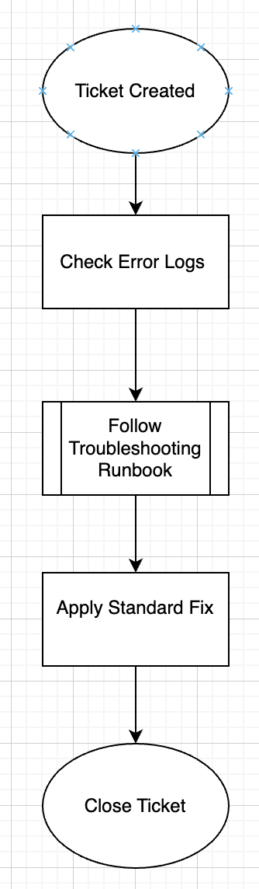
Traditional Workflow Design (Fixed Steps)
Linear Workflow
Characteristics:
Everything is predefined
Human follows a standard
operating procedure
Very little deviation
No intelligence,
only instructions
Pros :
1. Predictable
2. Easy to audit
3. Low risk
4. Works well for repetitive known issues
Cons:
1. Slow
2. Cannot handle new scenarios
3. Requires manual analysis
4. Depends heavily on individual experience

Slide 5
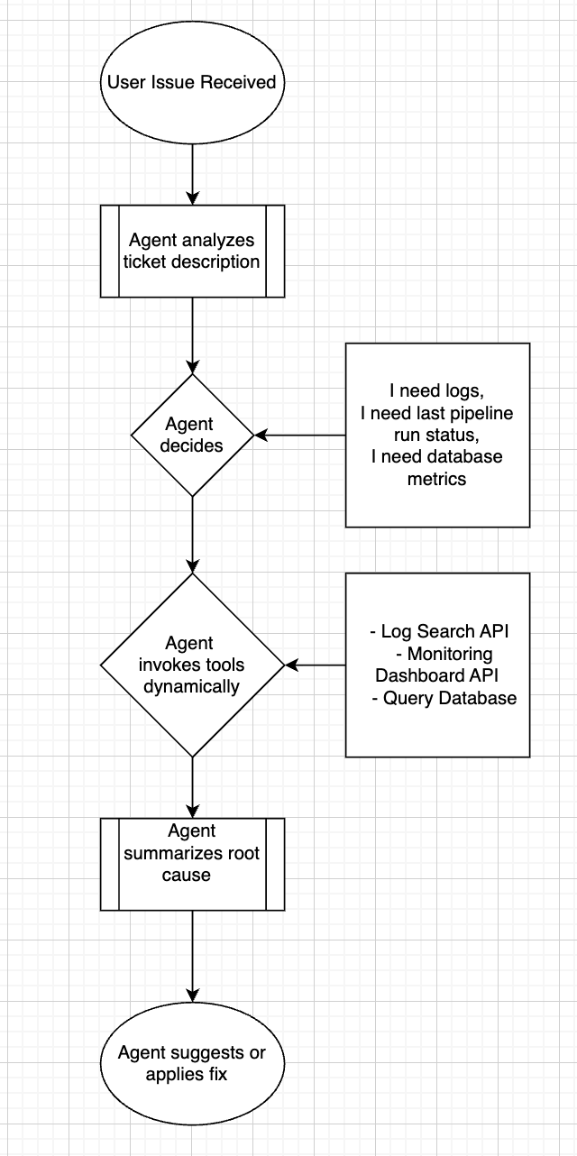
Redesign as an AI Agent
Agent-Based Design
Agent Behavior
The agent gets a request like:
“Data load failed for customer usage pipeline on 19-Jan”
Agent Thought Process
LLM Decision Flow:
“Based on situation X, I will use tools Y and Z”
Tools the Agent Can Use
Log retrieval API
SQL query tool
Monitoring system
Documentation search
Slack/Email notification tool

Slide 6
Example Agent Prompt Logic
Instead of:
“Follow Step 1, Step 2, Step 3”
The agent thinks like:
“This looks like a schema change issue → query metadata tool”
“This looks like missing file issue → check S3 bucket”
“This is authentication error → check credentials store”

Slide 7
Dynamic Flow Example
Input: “Pipeline XYZ failed”
Agent:
→ Classifies issue type
→ Decides tools needed
→ Runs diagnostics
→ Generates fix recommendation
→ Optionally auto-remediates

Slide 8
Comparison
Aspect | Traditional Workflow | AI Agent
Flow | Fixed steps | Dynamic reasoning
Flexibility | Low | High
Human Effort | High | Low
Speed | Slower | Faster
New Issue Handling | Poor | Good
Auditability | Very high | Medium
Risk | Low | Higher
Maintenance | Easy | More complex

Slide 9
When to Use What?
Use Predictable Workflow When:
Use Agent-Based Approach When:
Process is highly regulated
Steps never change
Compliance is critical
No ambiguity
“Known paths with known outcomes”
Examples :
Upload API
Authentication
Tasks involve reasoning
Many possible paths
Data is unstructured
Human judgment normally required
“Unknown paths requiring reasoning”
Examples:
File classification
User support emails
Monitoring alerts

